Slide 1
Optimization of neural networks structure by genetic algorithm
Didactic coordinator
Phd Henri Luchian
Graduate
Jean Arnaud Pierre Micheli

Slide 2
Summary
1 Genetic algorithms, neural networks, advantages
2 Encoding of neural network parameters
3 Results and improvements

Slide 3
Genetic algorithm
Non deterministic searching algorithm,
using random and heuristical operators,
on a population of solutions

Slide 4
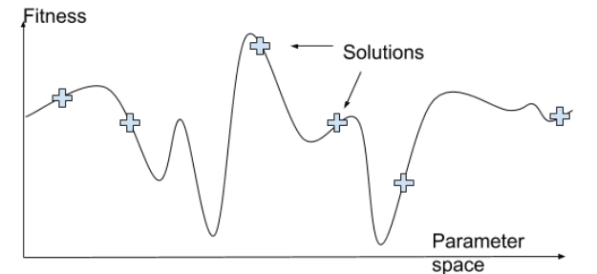
Genetic algorithm
The strength comes from parallelism :

Slide 5
Genetic algorithm
Parallelism requires diversity in the population, to be a representative sample of the parameter space.
Operators should conserve the diversity while optimizing each solution independently
Fitness function should contain few plateaus to respect the convergence

Slide 6
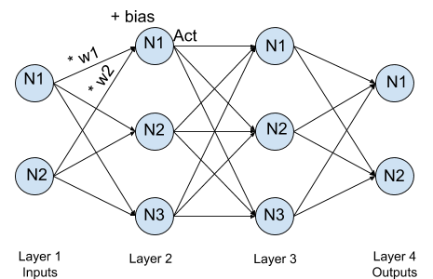
Artificial Neural Network
A neuron = weighted inputs sum which is then activated by a nonlinear function

Slide 7
Artificial Neural Network
The strength of the neural network is to be able to modelize any imaginable function with sufficient neurons.
This may require many parameters (weights and bias) which need to be well parameterized.
However, backpropagation with gradient descent learning optimizes all parameters almost at once.

Slide 8
Parameters of NN influencing results after learning
Initial weights and biases -> architecture & complexity
Number
Organization
Initial value
Activation function
Learning algorithm -> optimization
batch size
Learning rate
Regularization methods -> generalization
weight decay
dropout

Slide 9
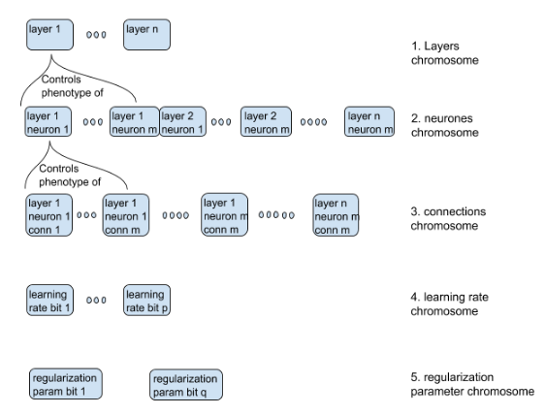
Multi-layer feed forward networks encoding
n : maximal number of layer
m : maximal number of neurons per layer
Why 5 chromosomes in a structured genome ?
More flexibility :
Different initializations
Different operations

Slide 10


Multi-layer feed forward networks encoding
Initial weights and biases -> architecture & complexity
Number
Organization
Initial value
Activation function
Learning algorithm -> optimization
batch size
Learning rate
Regularization methods -> generalization
weight decay
dropout

Slide 11
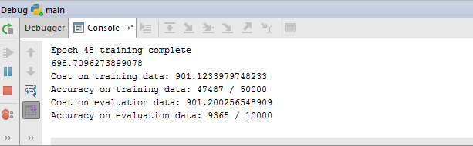
Primary results on MNIST digit dataset
PROBLEM - Computation time : 48 * 700 > 8 hours for only one individual !
SOLUTION - Less numerous training units or less complex problem.
- Control the curve of accuracy on validation set.
if accuracy > best_accuracy * minimal_accuracy_gain_slope:

Slide 12


Secondary results on reduced MNIST digit dataset
Faster time of computation for an epoch lower complexity
Best individual on 1st generation.
Balance found between under and overfitting ?
Vanishing gradient problem, reducing the number of layers ?
Best individual on 3rd generation.

Slide 13
Conclusion
Limited results on a scientific plan
Non generalised results
Analysis of population diversity on long run would be necessary
Recent researches in neuro-evolution not taken in consideration
No comparison with other methods (ex: grid search)
A strong basis which can easily be ameliorated
The genetic algorithm provides reasonably good initial parameters
Optimization and Generalization ensured gradient descent and early stopping
Automated method applicable on any classification problem
Personal : limits of problems abstraction

Slide 14
Thank you for your attention !

